Slide 1

Blue Birds

Slide 2
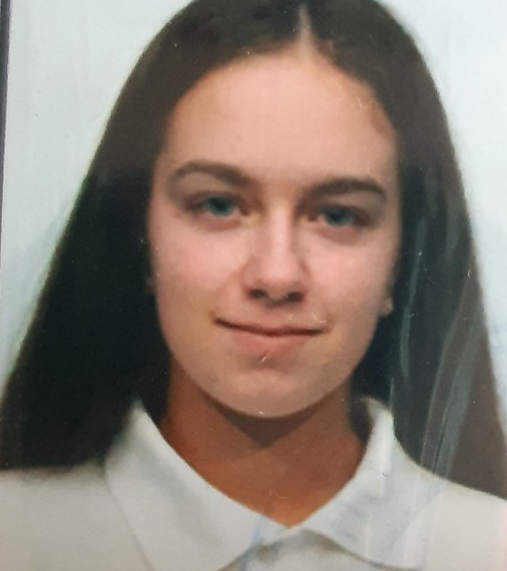
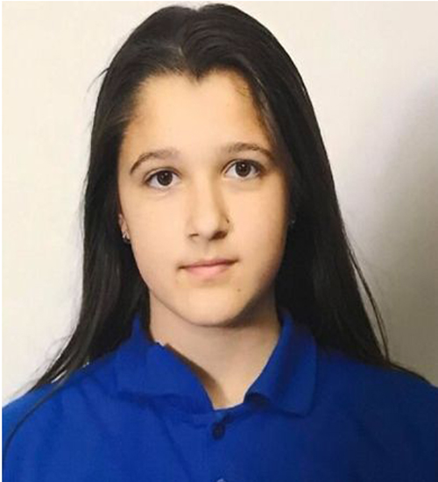
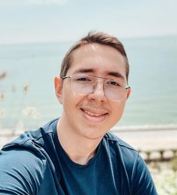
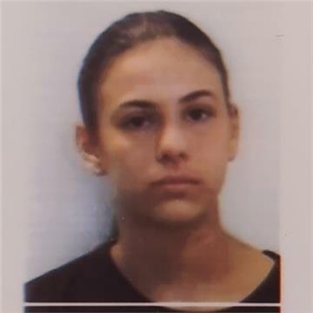
Our team
Valeria Yaneva
BackEnd
Zhanet Petkova
BackEnd
Soner Solakov
Scrum trainer
Victoria Bolashikova
QA Engineer

Slide 3
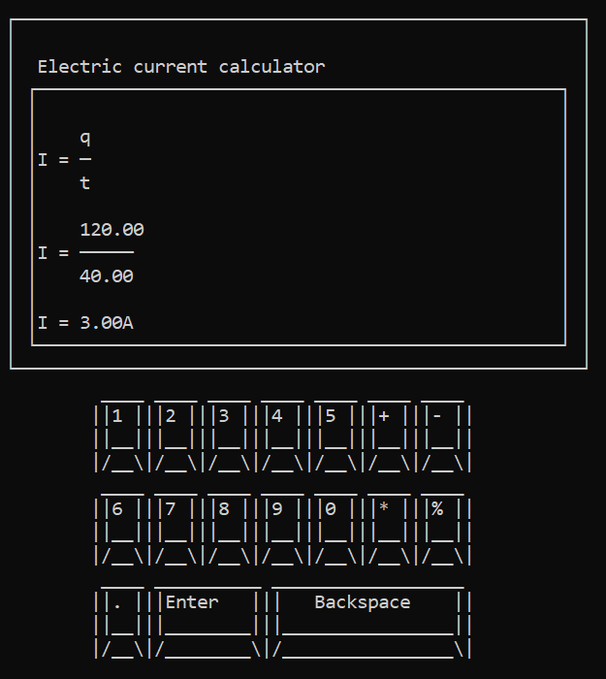
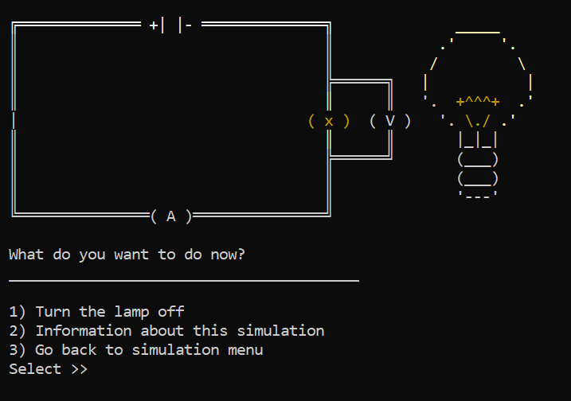
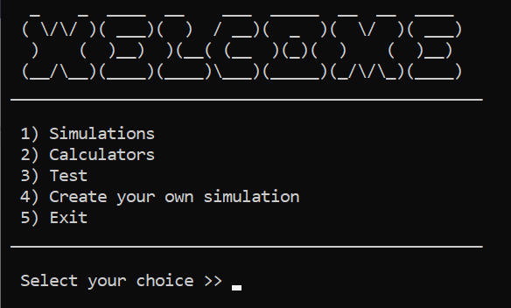
Our idea

Slide 4



Stages of development
3.
1.
2.

Slide 5










The programs we used

Slide 6
Let’s jump to the project!

